Slide 1
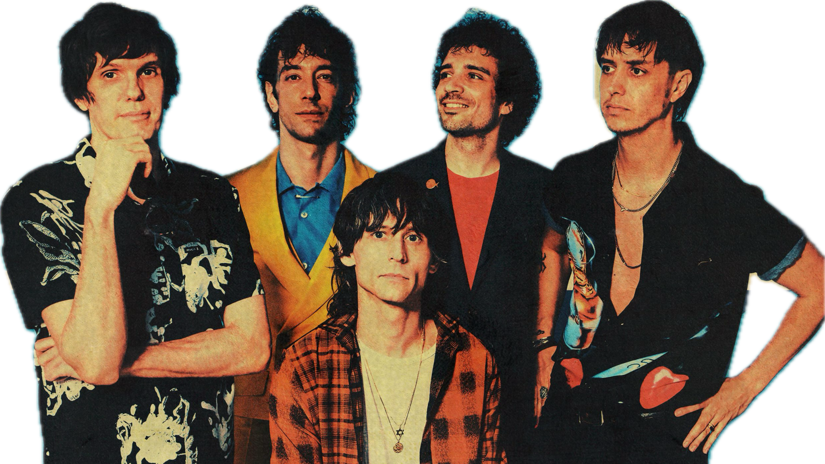
THE STROKES
Ehsan, Natalie, Nathaniel, Aimee

Slide 2
ABOUT US
We are agents scouting for the next indie band…
We are agents scouting for the next indie band…just kidding y’all!

Slide 3
ABOUT US
We are agents scouting for the next indie band…just kidding y’all!
We are agents scouting for the next indie band…just kidding y’all!

Slide 4
ABOUT US
We are agents scouting for the next indie band…just kidding y’all!
We are agents scouting for the next indie band…just kidding y’all!
We are Care About U, a healthcare company analyzing the general population’s stroke frequencies and their potential contributors.

Slide 5
GOALS
Isolate and analyze each contributor to aid in the prevention/minimize the frequencies of strokes.
Determine who will be most at risk within our customer set
To make our jobs easier, build a ML model!

Slide 6
Contributing Factors of Strokes
Residence location
Gender
Career type
Age
Smoking status
Hypertension
Marriage status
BMI

Slide 7
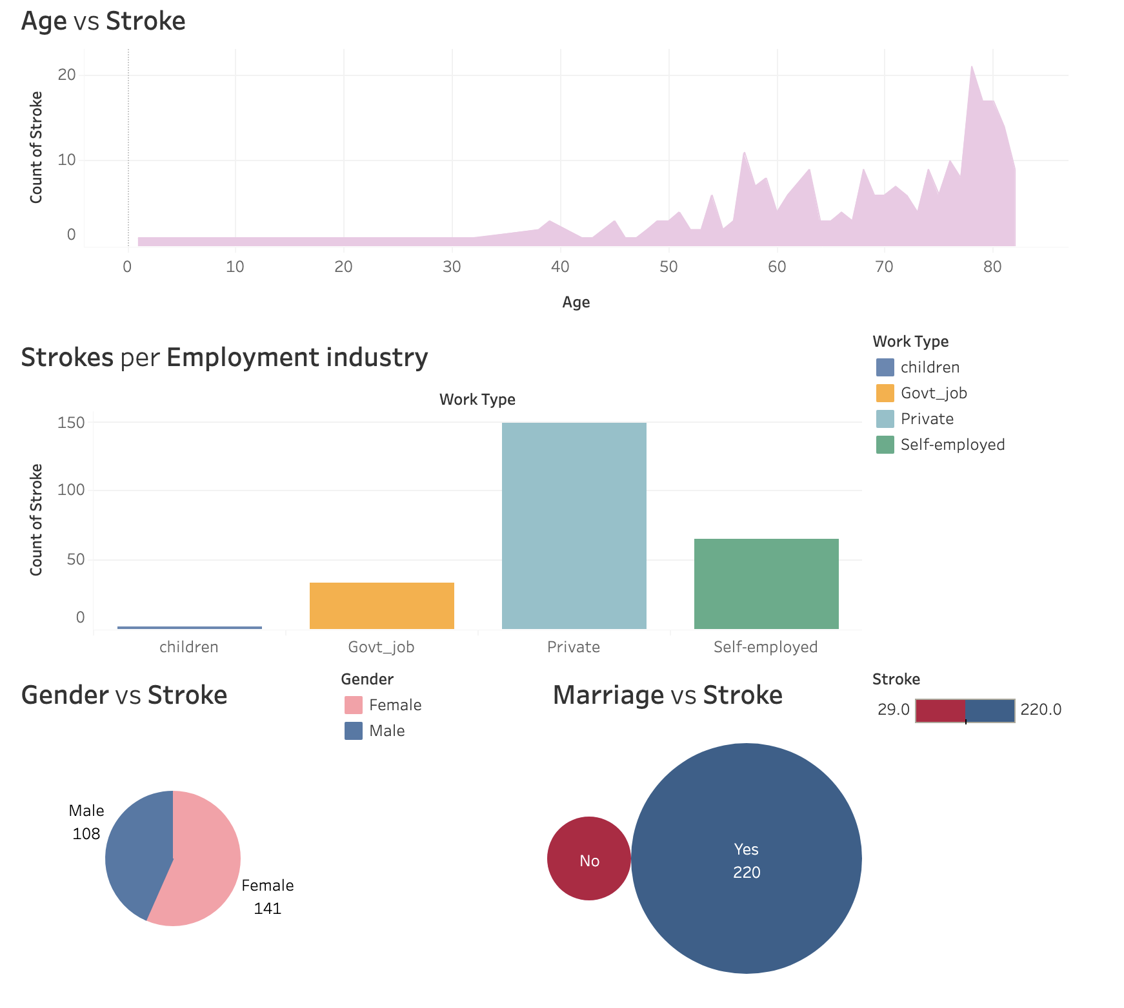
Dashboard

Slide 8
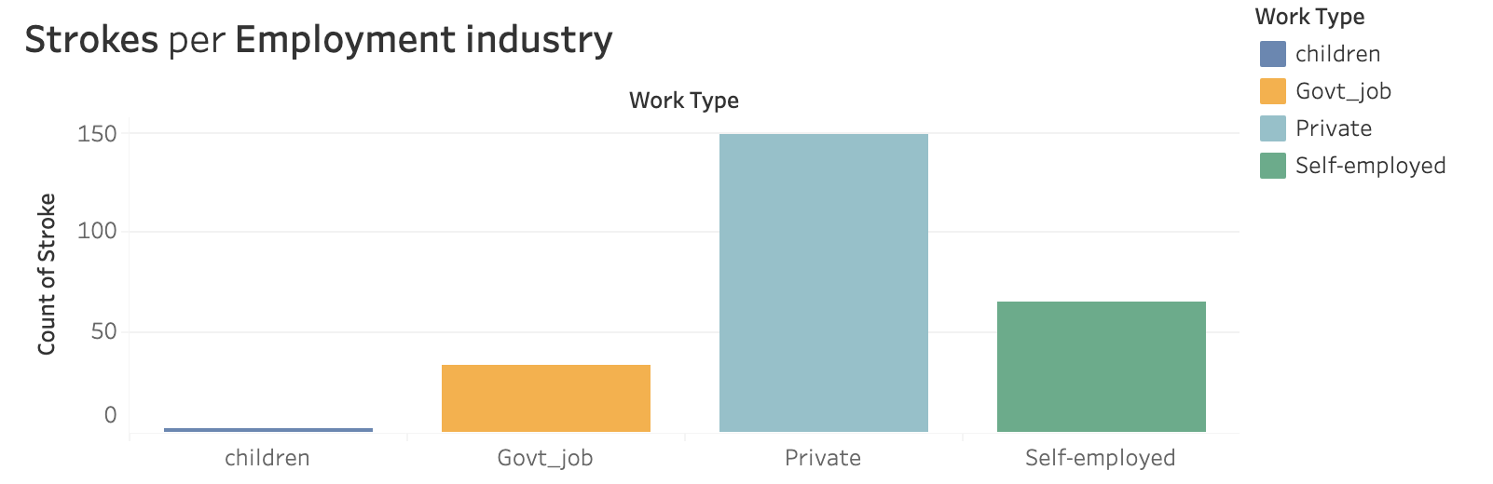
Which Employment Industry Has the Most Strokes?
* “Children” is not a work type

Slide 9
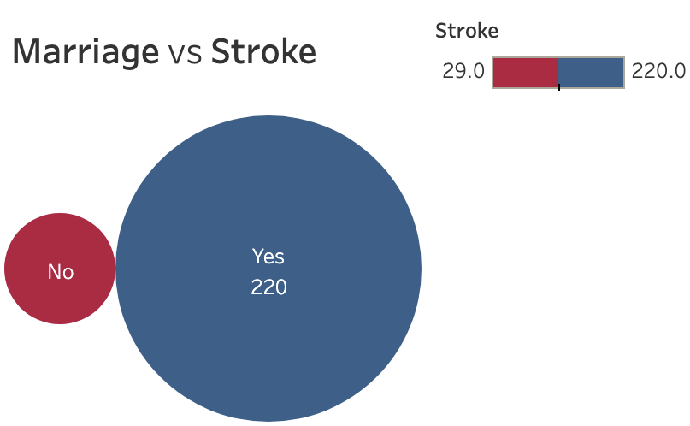
Does Marriage Increase the Risk of Stroke?

Slide 10
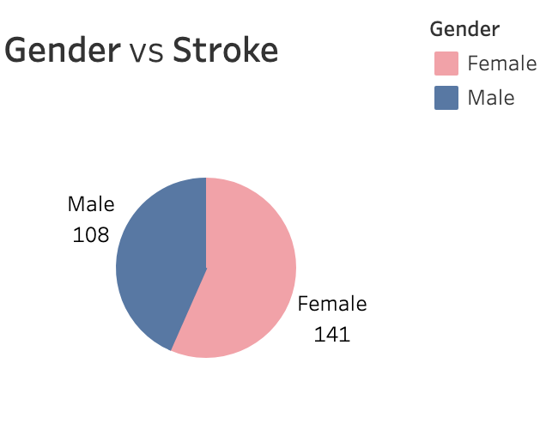
Does Gender Have an Impact on Stroke?

Slide 11
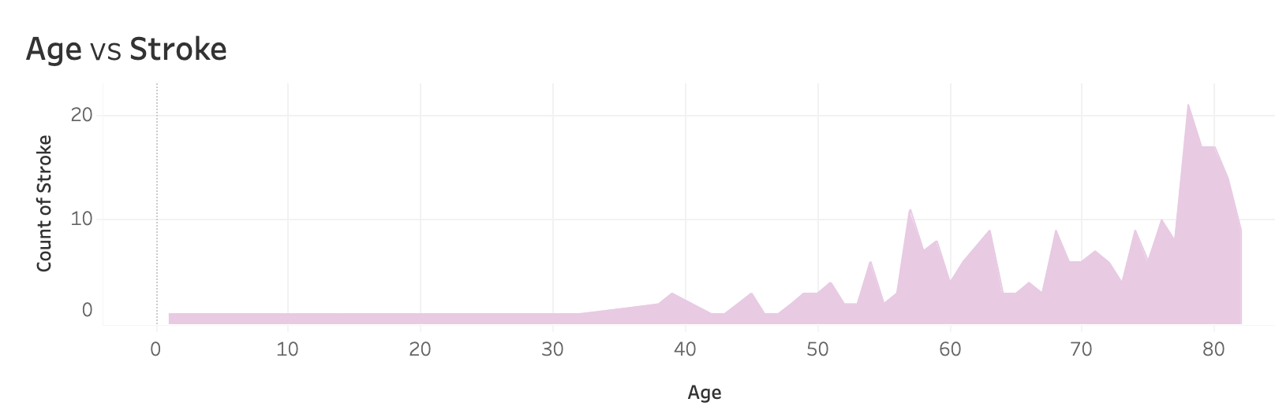
Does Age Affect Strokes?

Slide 12
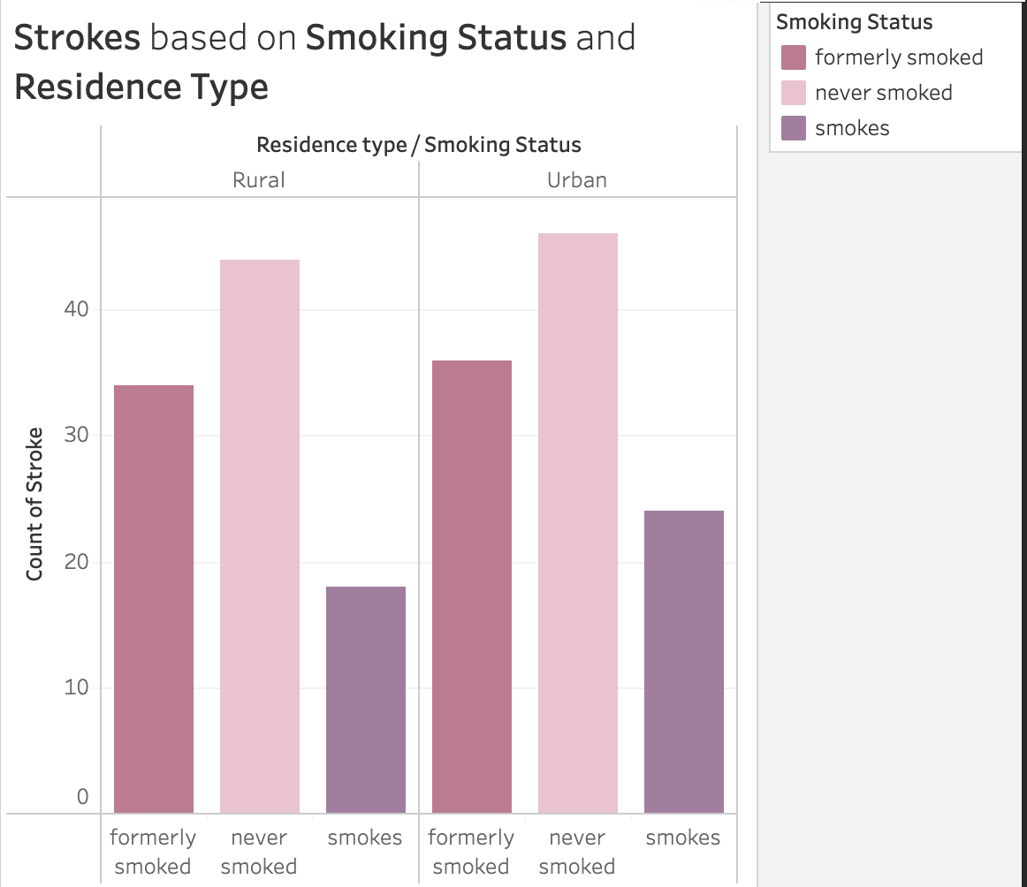
Does Smoking Status and Residence Type Have an Impact on Strokes?

Slide 13
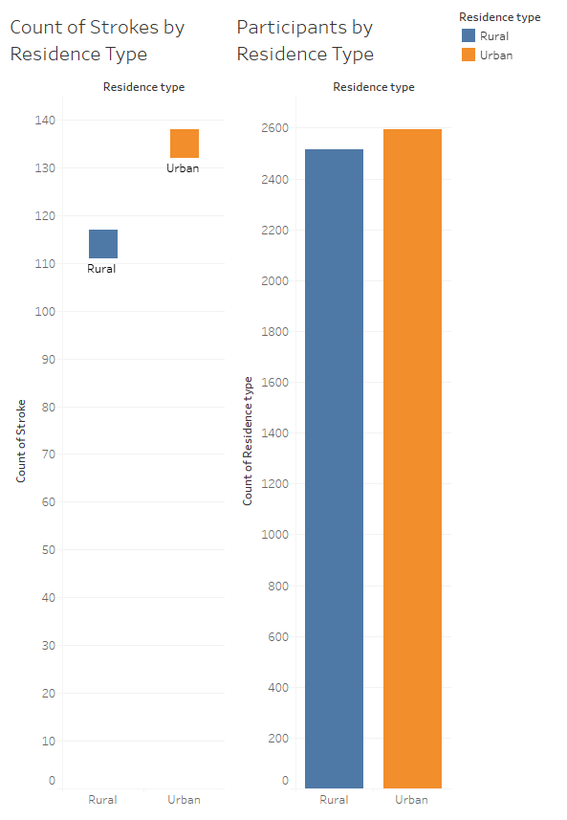
Does location play a part in stroke risk? Urban vs. Rural

Slide 14
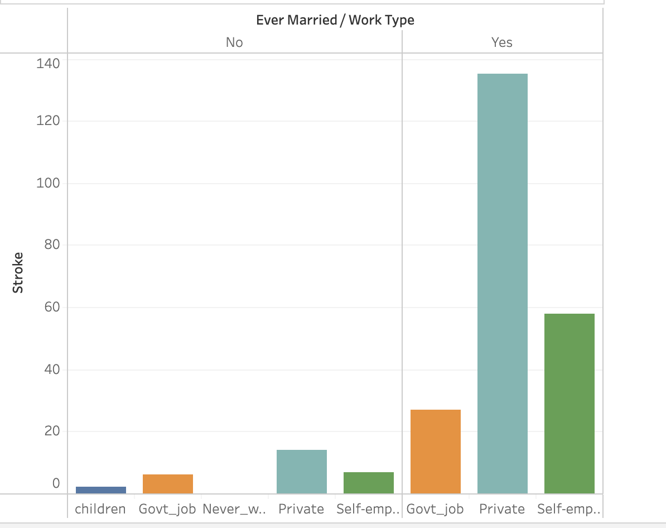
Can being married and working raise the chance of getting a stroke?

Slide 15
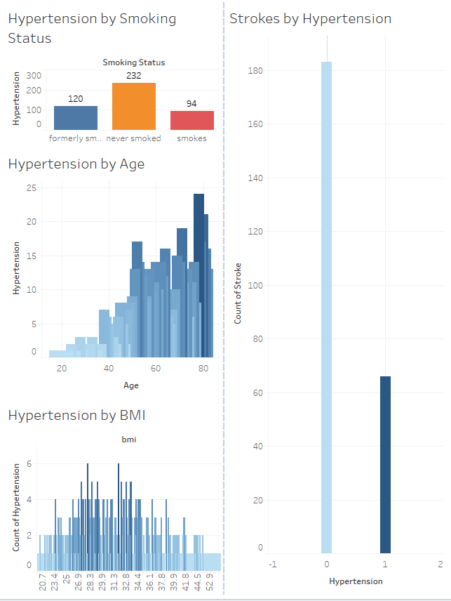
Hypertension Dashboard

Slide 16
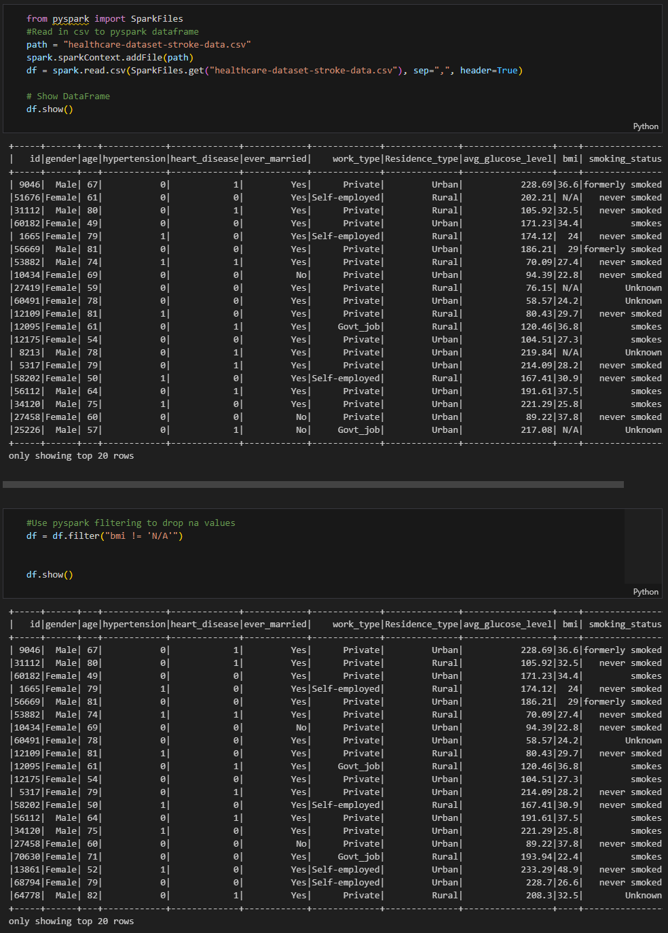
Loading our Data
Spark
Removing N/A Data

Slide 17
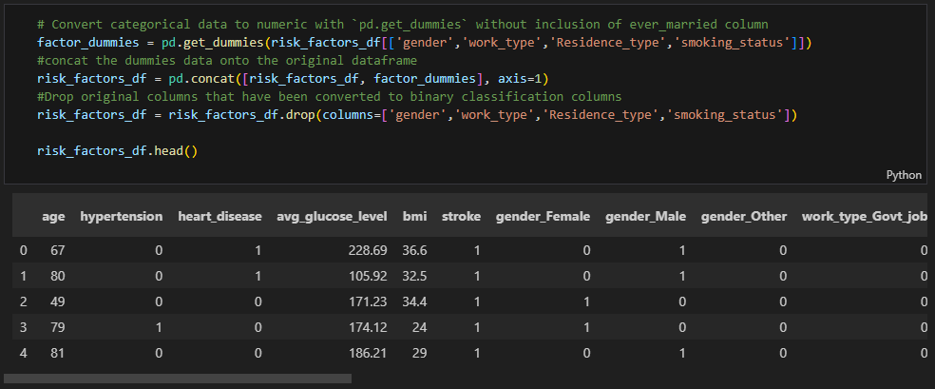
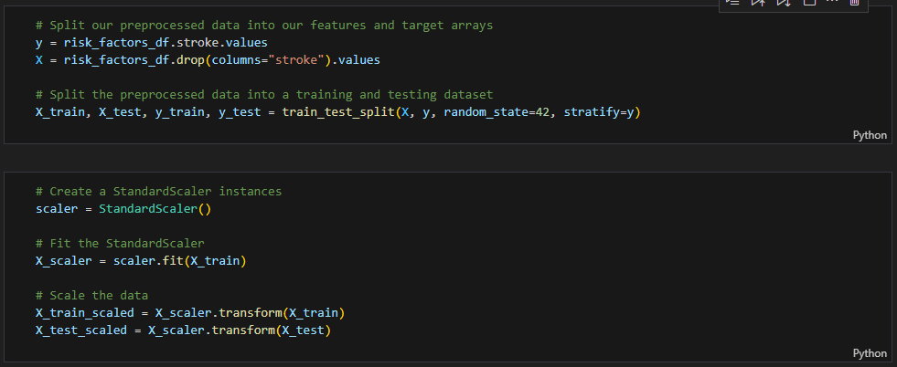
Preparing Data
Convert Data fields to Binary Classification
Set Features and Target Array
Split Data into training and test data
Scale the data using StandardScaler

Slide 18


Model Structure
Using Keras Sequential Model
Three-layer model
Model Optimization
The model has a 94.95% chance of accurately predicting a stroke.

Slide 19
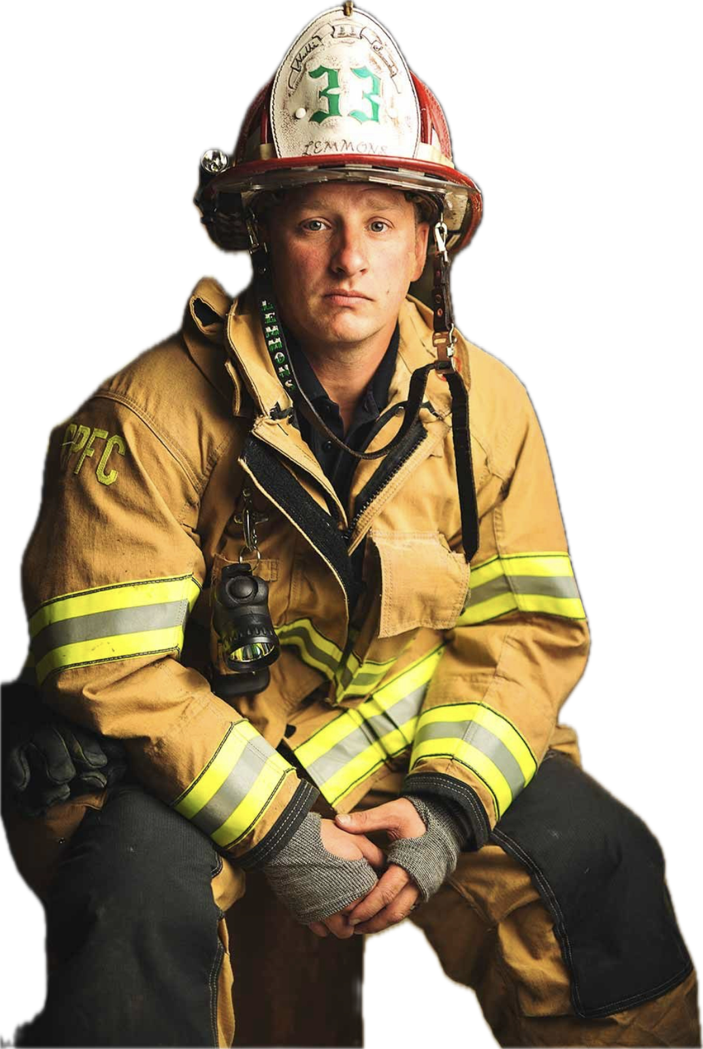
Who is least likely to have a stroke?

Slide 20
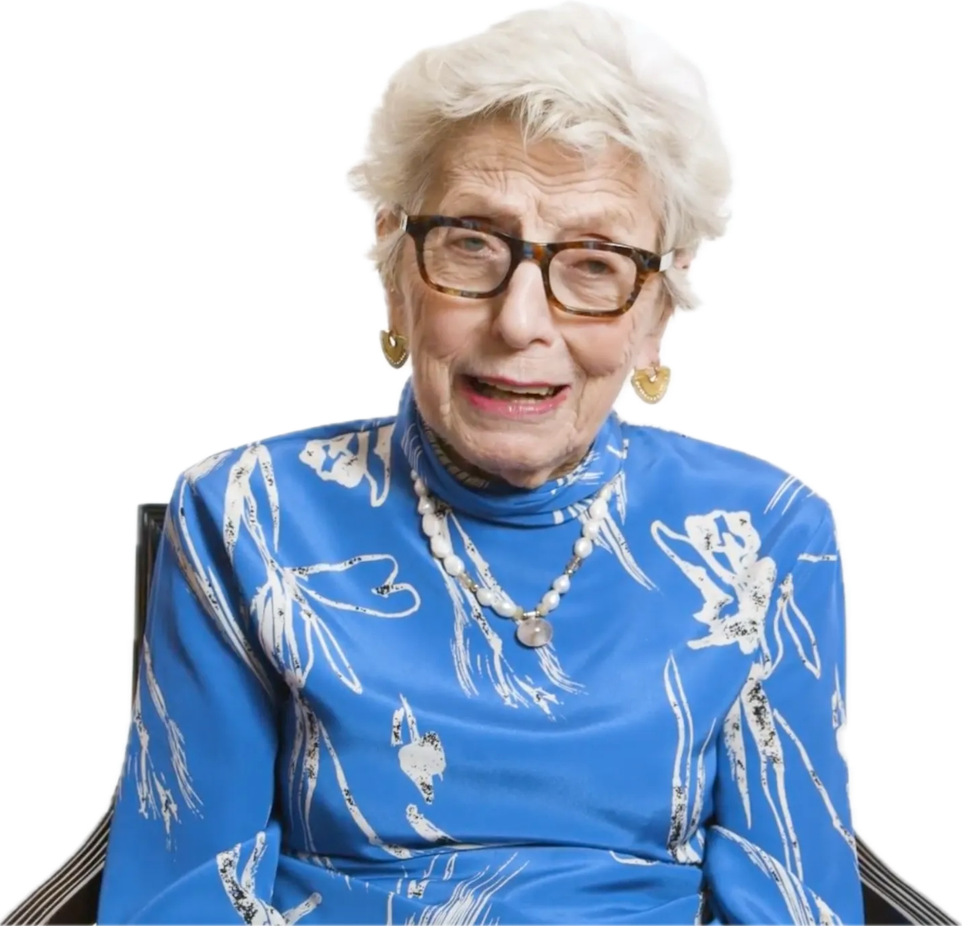
Who is most likely to have a stroke?

Slide 21
How could we improve this study?
Measure cortisol to visualize stress levels better
Understand that BMI is an unreliable factor
Incorporate Race and Ethnicity as factors as well
Expand and have more details of data pools
Include non-binary genders
Quality of the marriage/life partnership
Are there partnerships that are long-term and informal?
Does bringing the legal system into a relationship cause more strokes?

Slide 22
Thank You!
Data Source: https://www.kaggle.com/datasets/fedesoriano/stroke-prediction-dataset

